Slide 1
Wadsleyite Synthesis for Laser Driven Shock Experiments
By: Jacqueline Tappan
Mentors: S.-H. Dan Shim & Kurt Leinenweber
School of Earth and Space Exploration
ASU

Slide 2
Laser Driven Shock
Laser beams shock material producing high pressure and temperature conditions similar to those found in the deep interiors of the Earth or in large Earth-like exoplanets.
Shock experiments require a dense starting material to then transform to its high pressure polymorph.
If a less dense material is used, upon shock, the material will act as a fluid.
Forsterite Wadsleyite High Pressure Polymorph
Increasing pressure

Slide 3
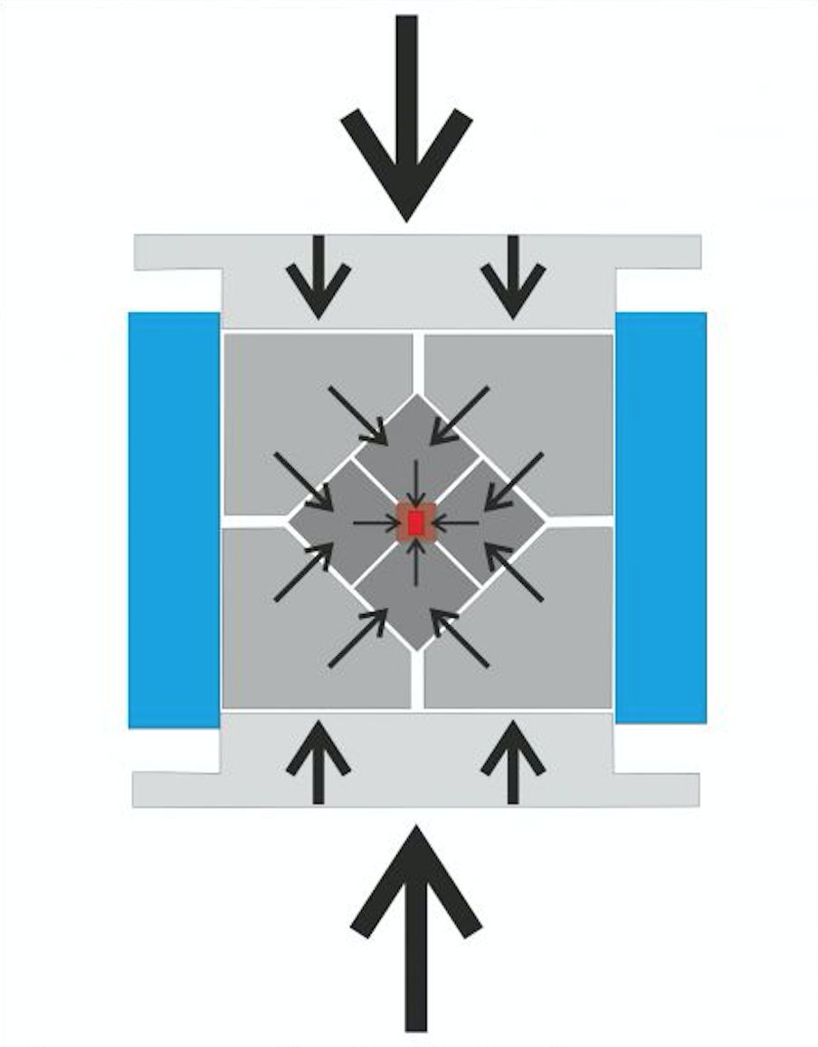
Synthesizing Wadsleyite
Forsterite Wadsleyite
A high pressure/high temperature multi-anvil press was then used to apply desired conditions to the sample
Synthetic forsterite (Mg₂SiO₄) was used as a starting material

Slide 4
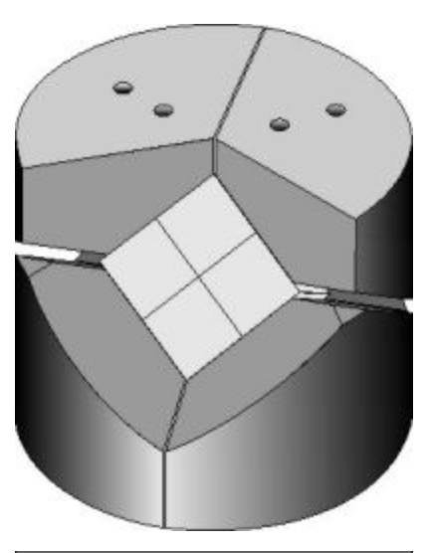
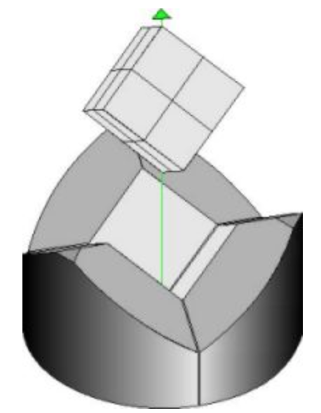
Multi-Anvil Press
6-8 Kawai and Endo type Multi Anvil was used in this experiment at Arizona State University
6 steel wedges and 8 Tungsten Carbide cubes
The National Centre of Experimental Mineralogy and Petrology. (n.d.). Retrieved from http://ncemp.org/MultiAnvil.htm

Slide 5
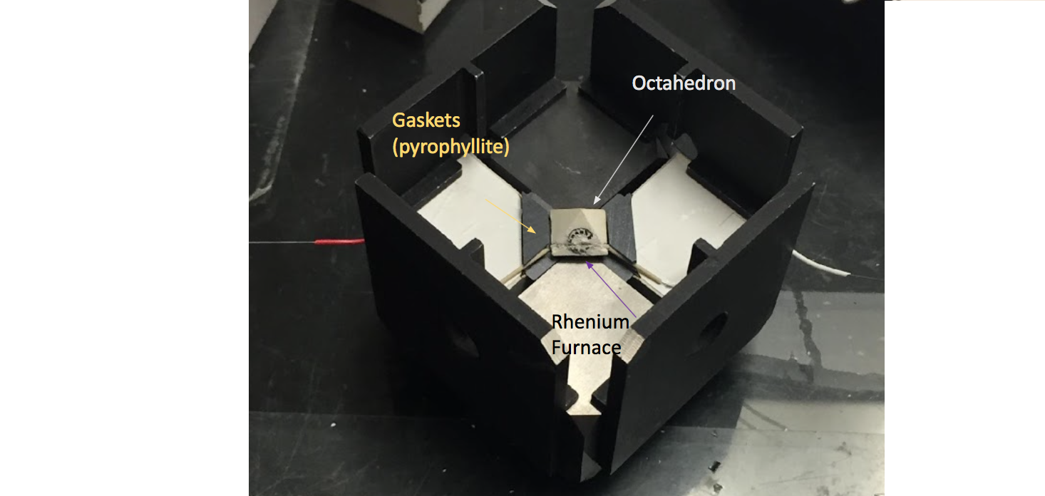
A look Inside the Assembly
(Mgo)
Nesting Plates

Slide 6
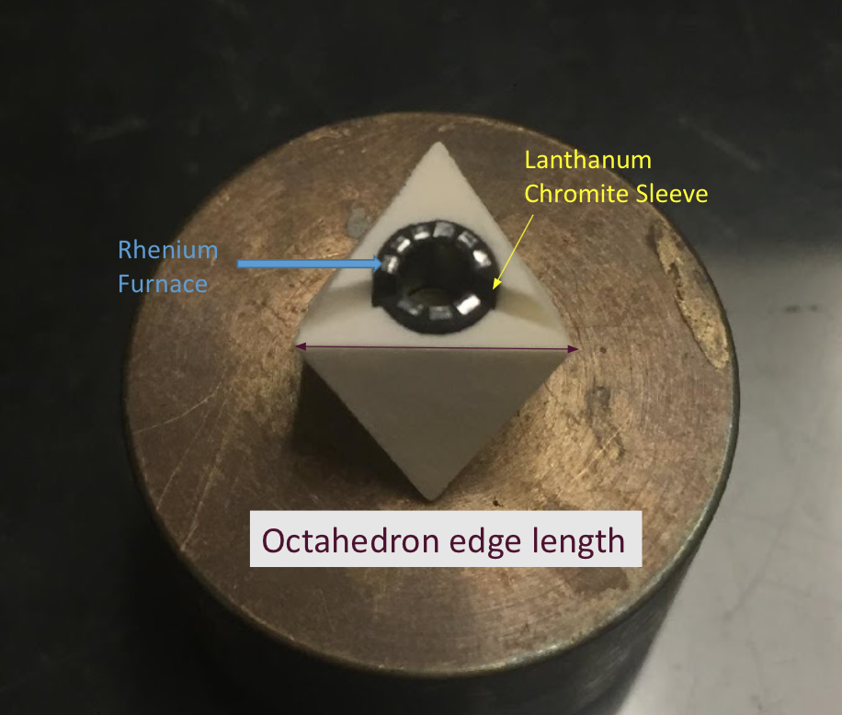
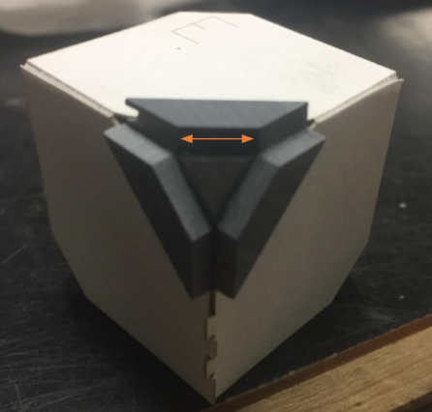
14/8 Assembly
14/8 refers to the edge length of the octahedron and the truncation on the tungsten carbide cubes.
14mm = Octahedron edge length 8mm = Truncation Length
8mm
14mm

Slide 7
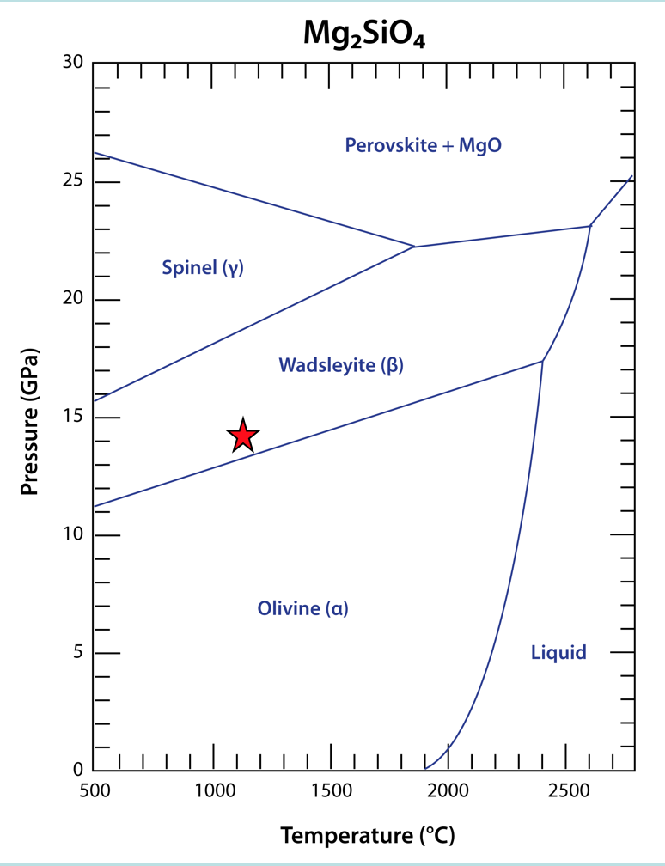
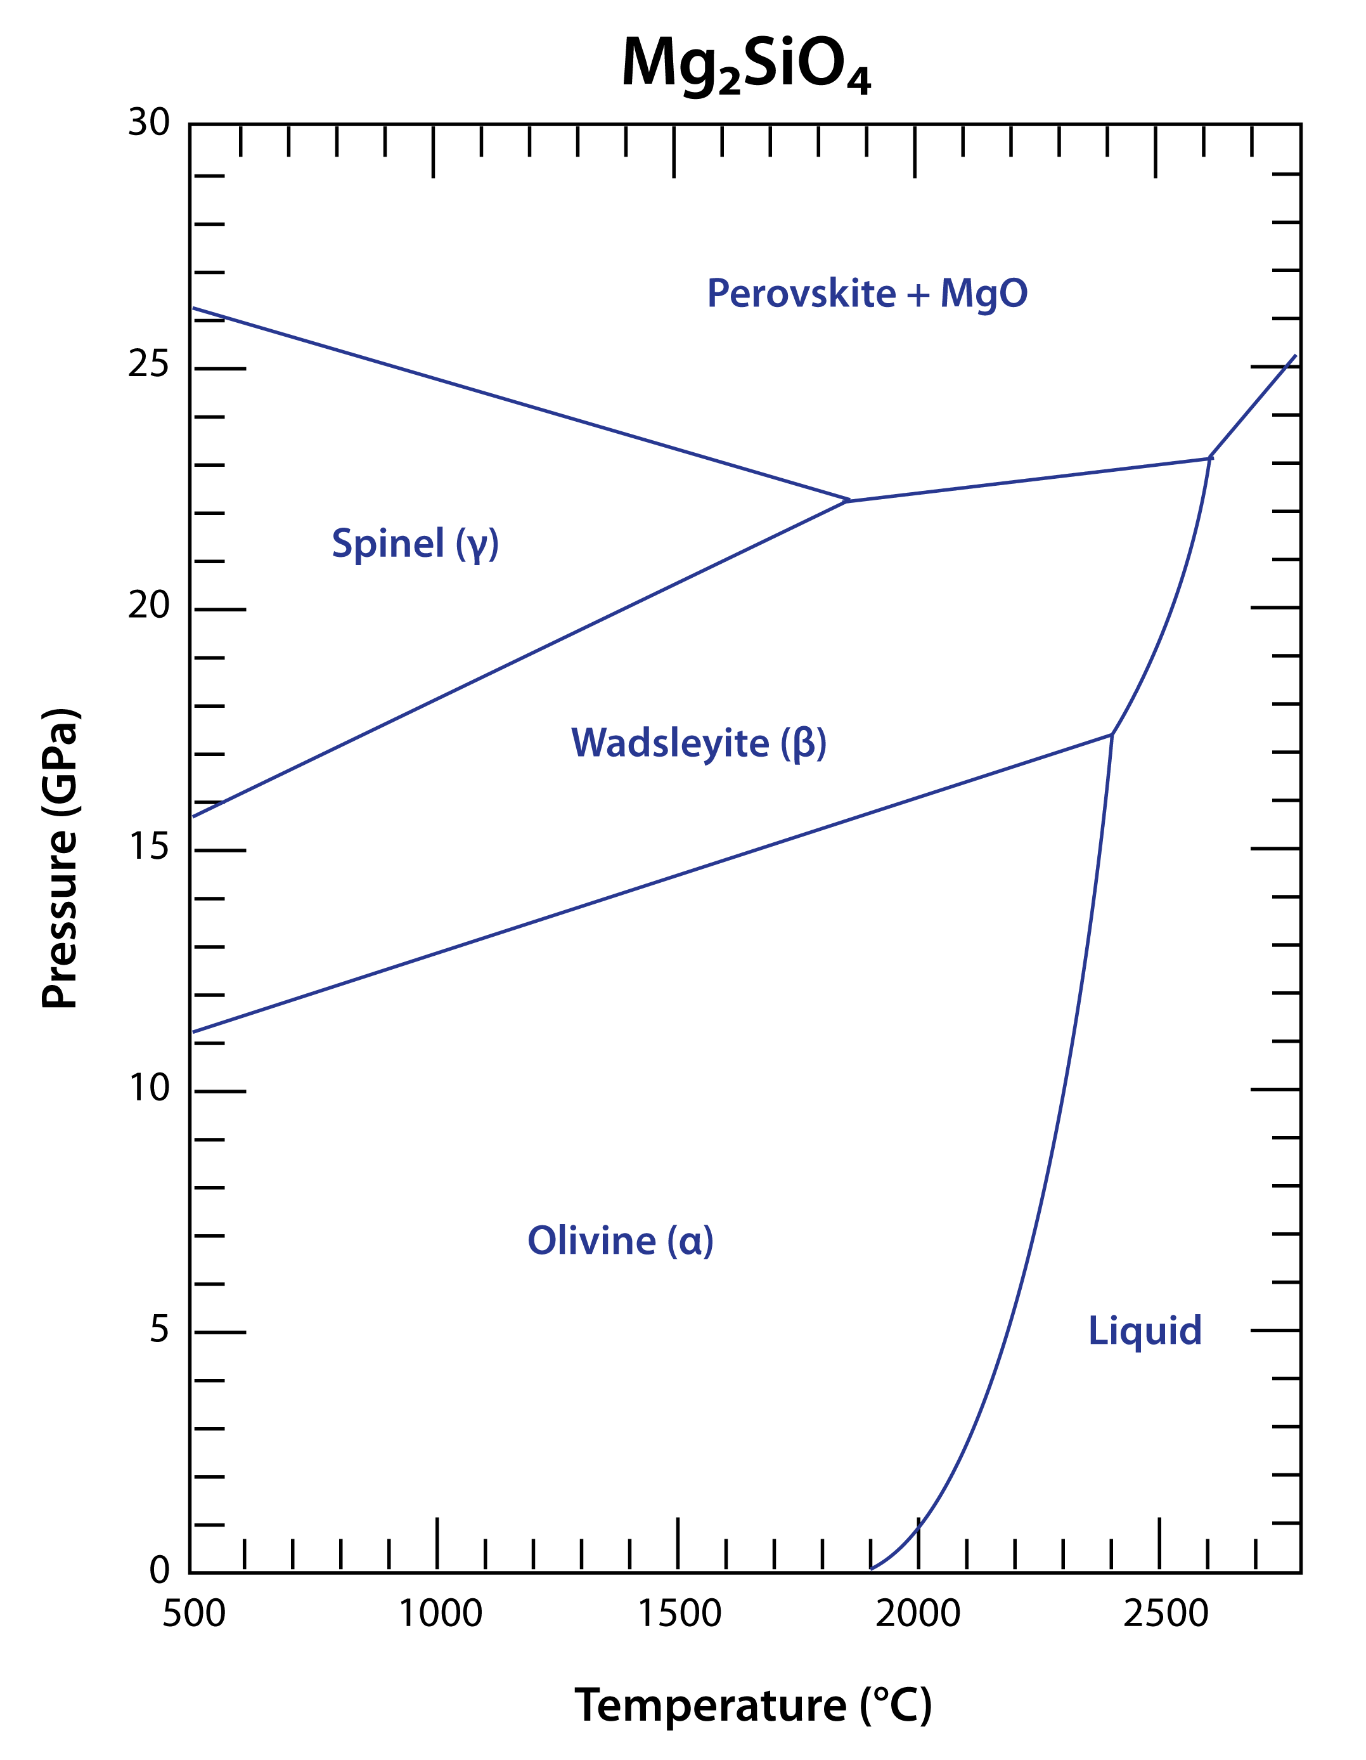
Run Conditions
1150º C
14 GPa
dwell for 2 hours before quenching
= Run Conditions plotted on Mg₂SiO₄ Phase Diagram
Burnley , P. (2016, November 15). Phase Equilibria at High Pressure

Slide 8
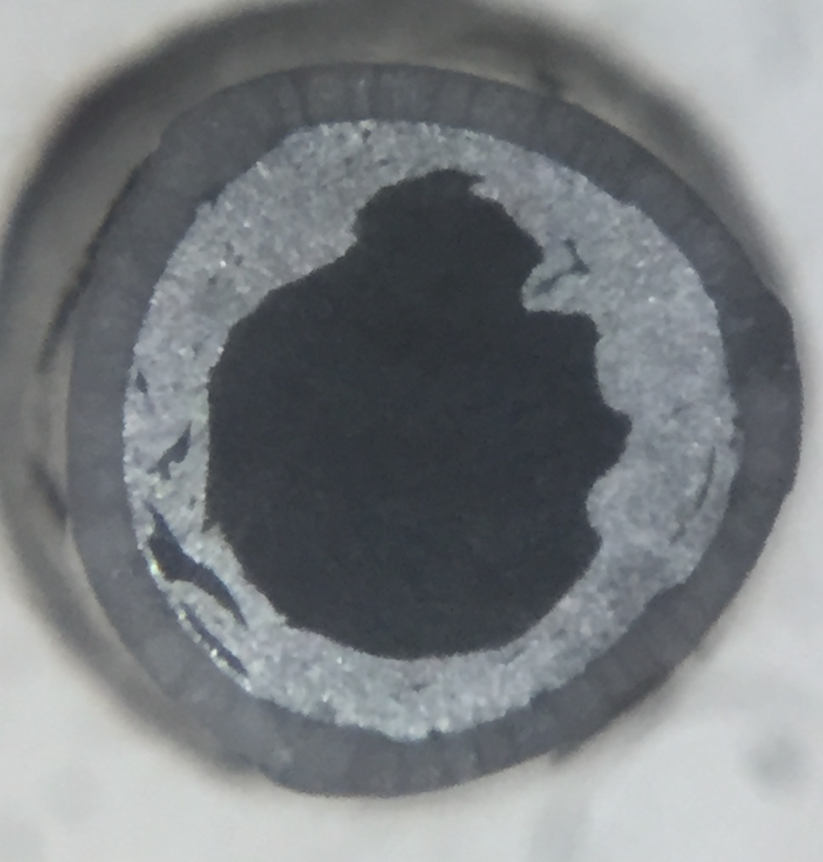
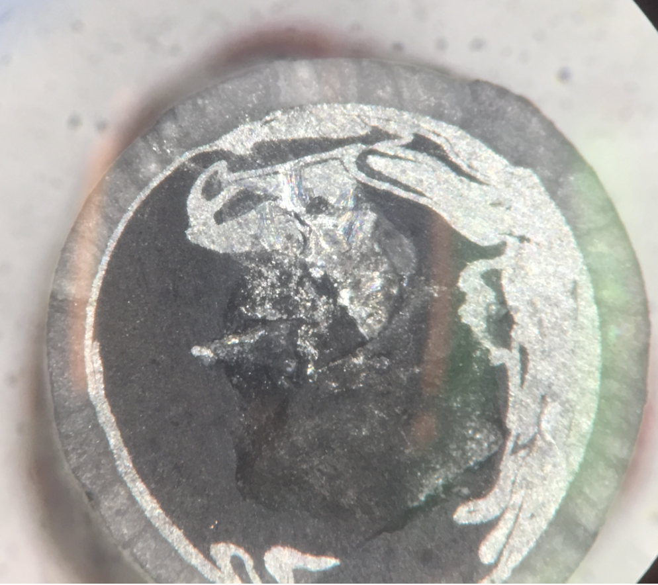
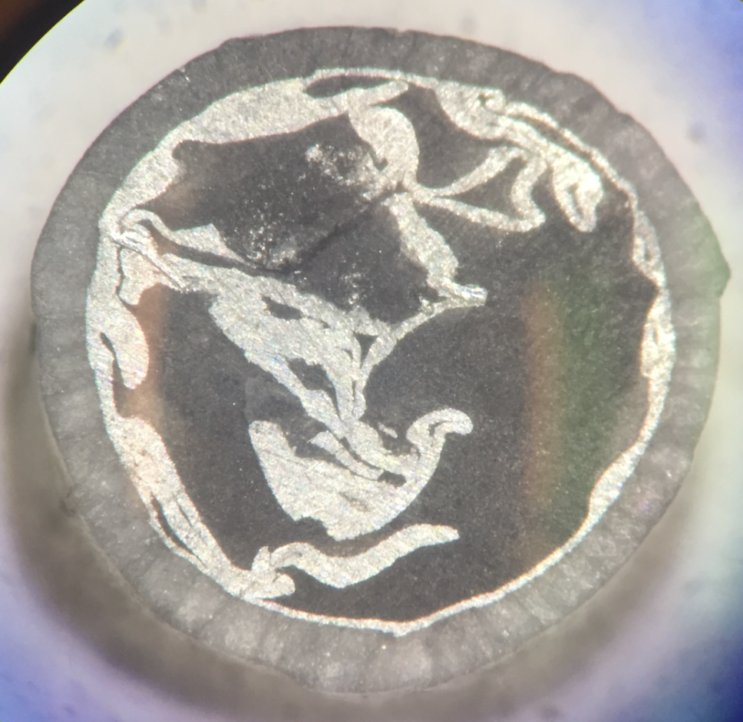
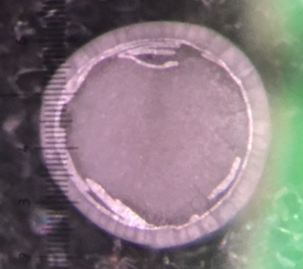
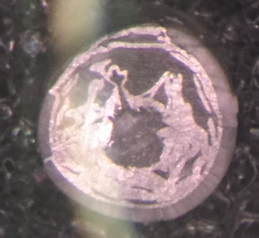
Results
A total of 5 multi-anvil runs were done at these conditions, each checked with Raman Spectroscopy to confirm that they were indeed wadsleyite
3mm
3mm
3mm
3mm
3mm

Slide 9
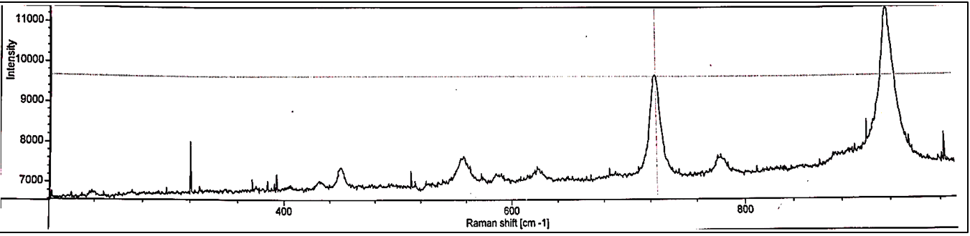
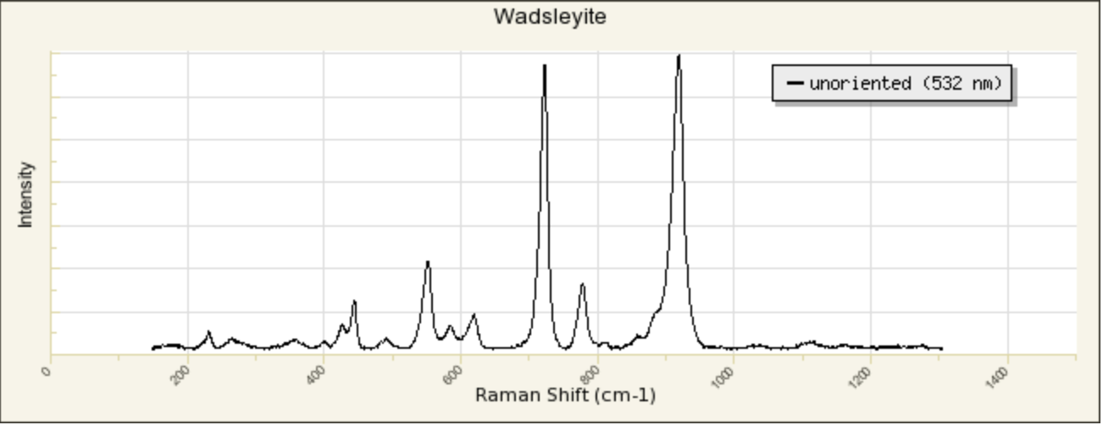
Raman Spectrum
http://rruff.info/wadsleyite/display=default/

Slide 10
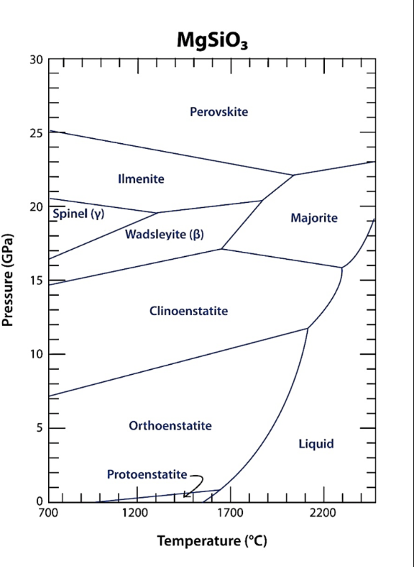
Future Research
Synthesizing Akimotoite, Majorite, and Bridgmanite at different conditions to understand the triple point in the MgSiO₃ system.

